Slide 1
Raspberry pi 3應用探討
周毓伶 2018/11/08報告

Slide 2
Contents
Raspberry pi 3
Hardware
Software
Simulator
Application
Reference

Slide 3
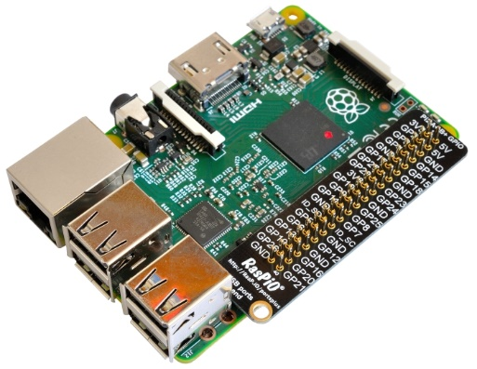
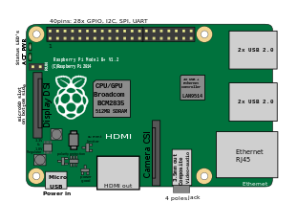
Raspberry pi

Slide 4
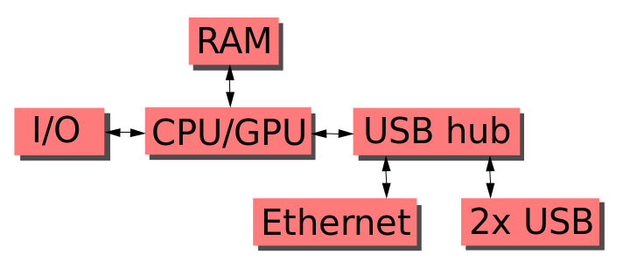
Raspberry pi-Hardware

Slide 5
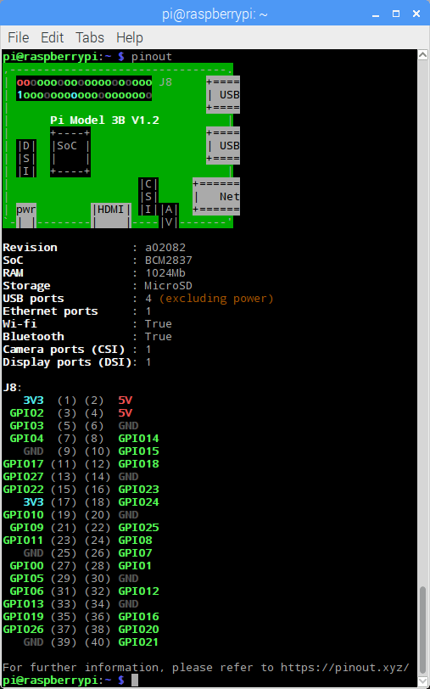
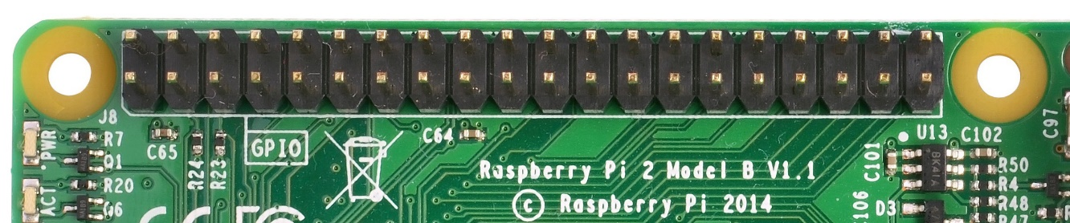
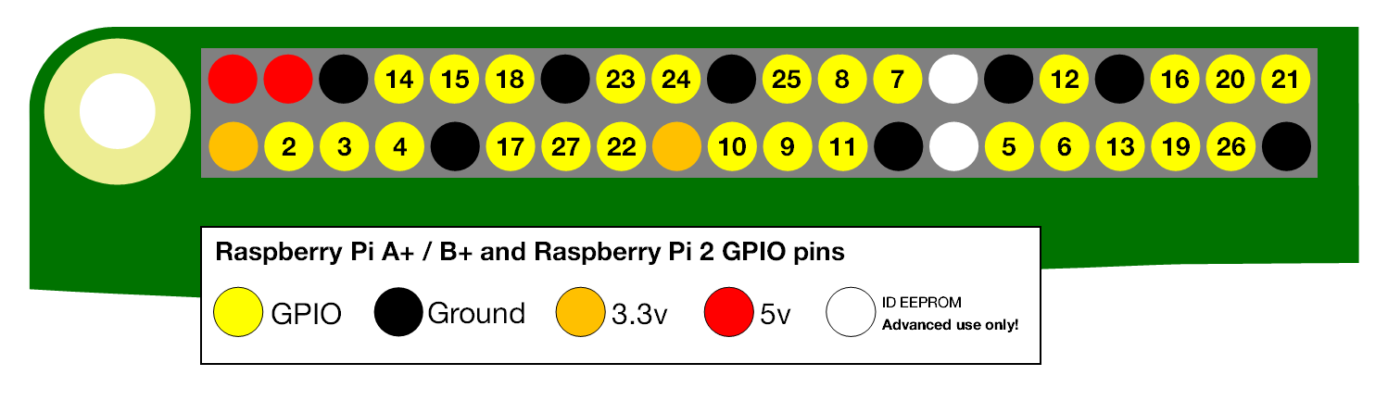
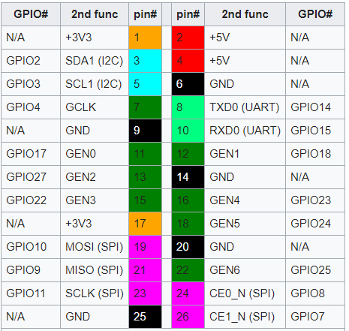
GPIO

Slide 6
Raspberry pi-Software

Slide 7
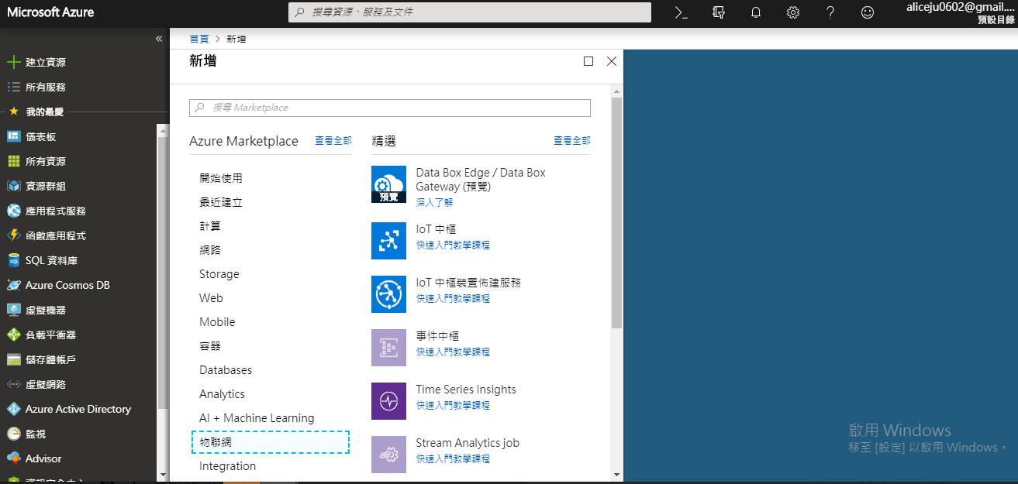
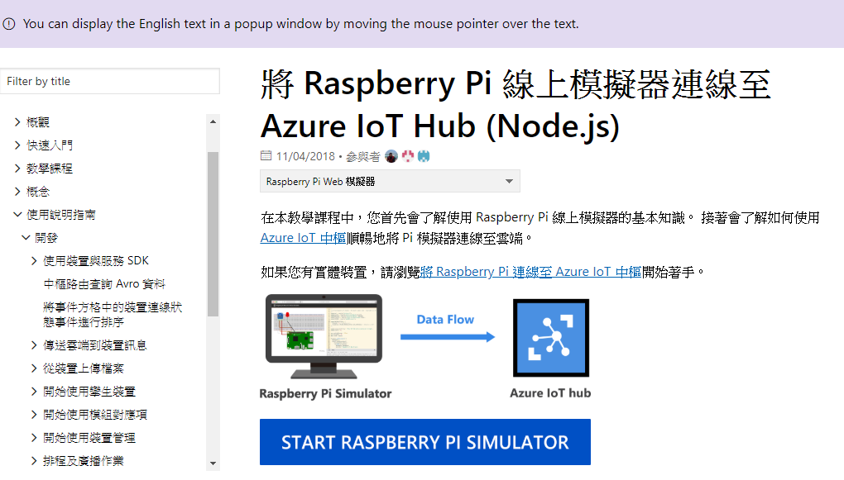
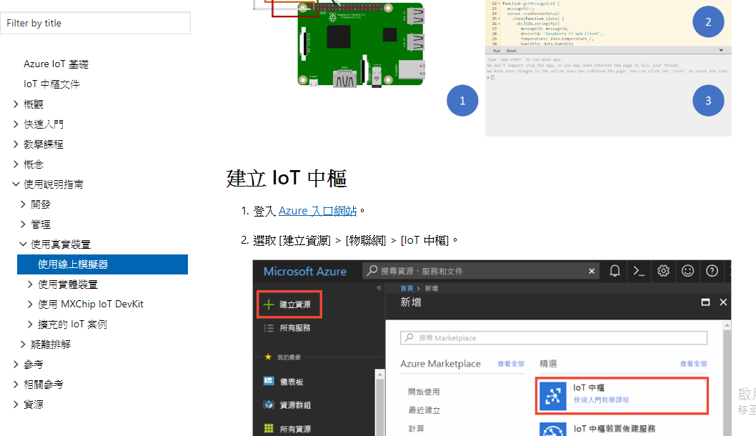
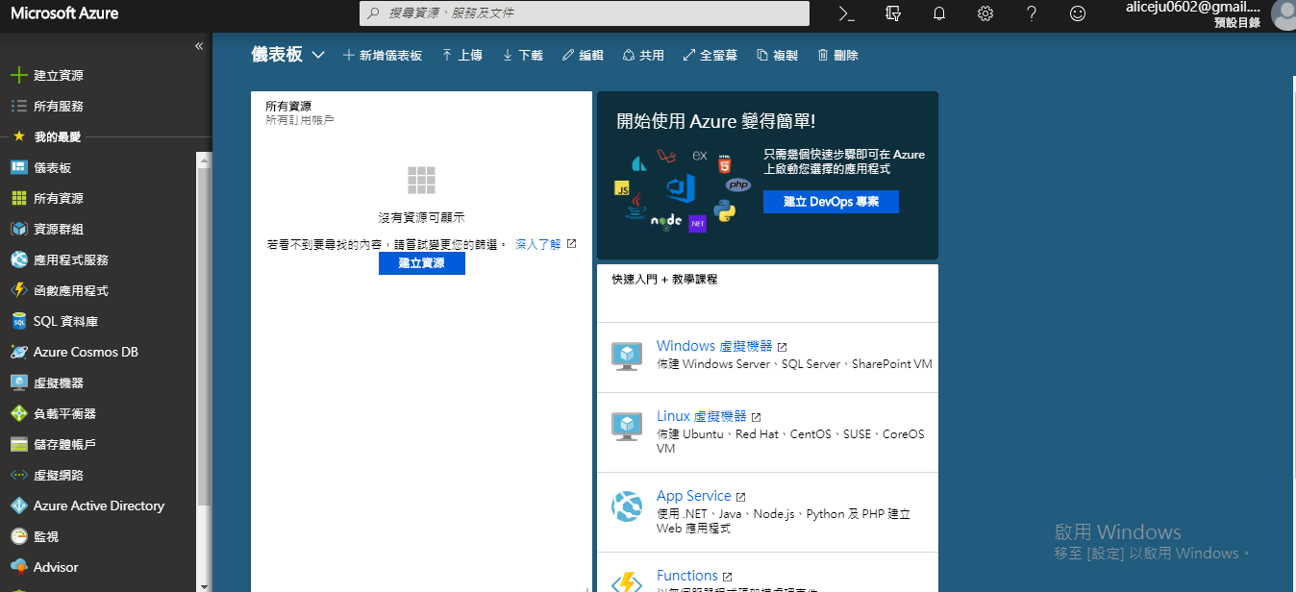
Simulator
https://docs.microsoft.com/zh-hk/azure/iot-hub/iot-hub-raspberry-pi-web-simulator-get-started

Slide 8
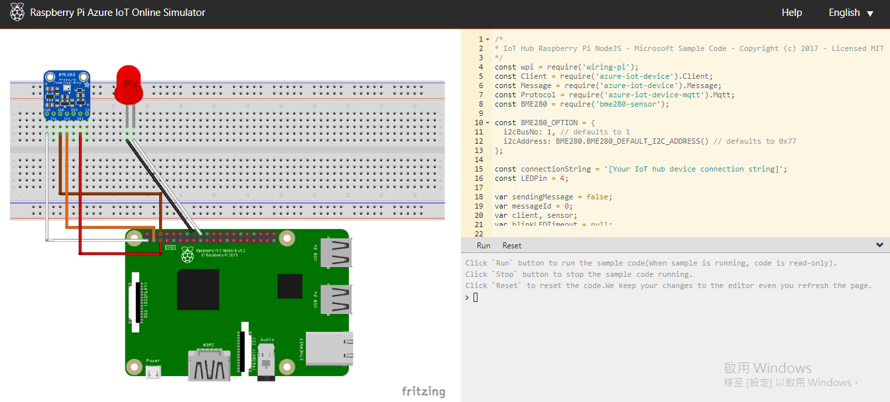
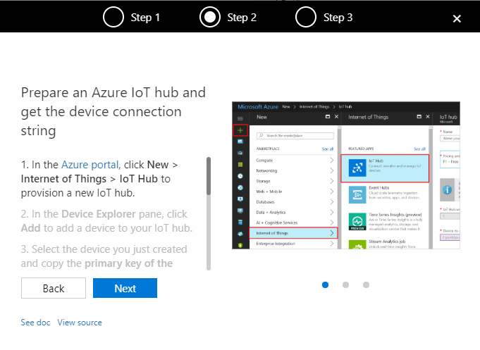
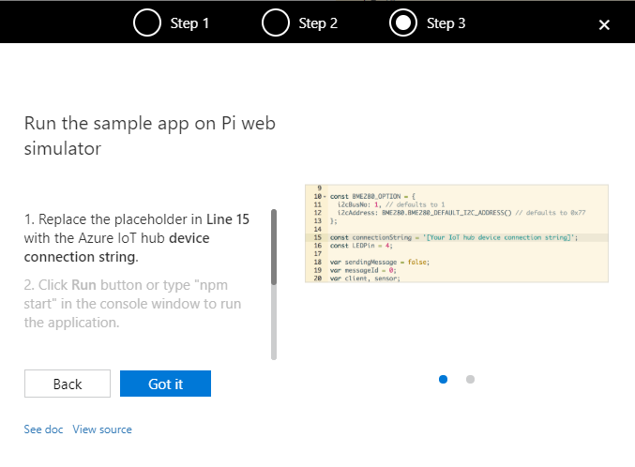
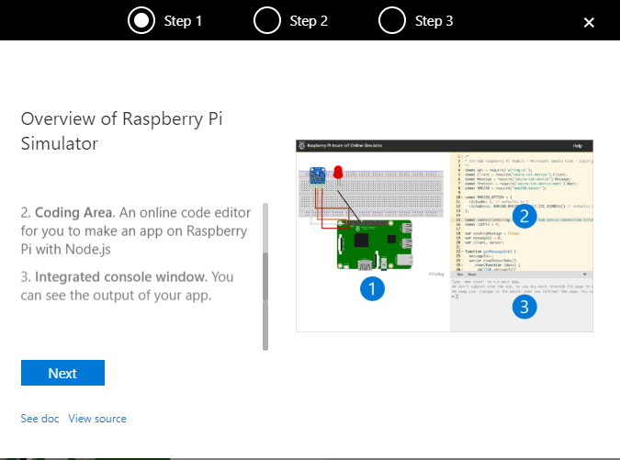
Simulator

Slide 9
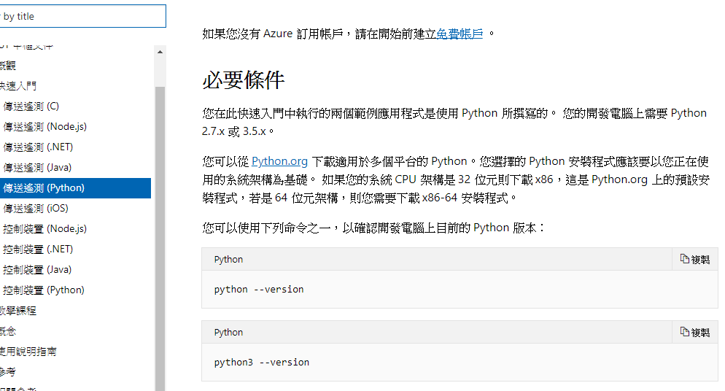
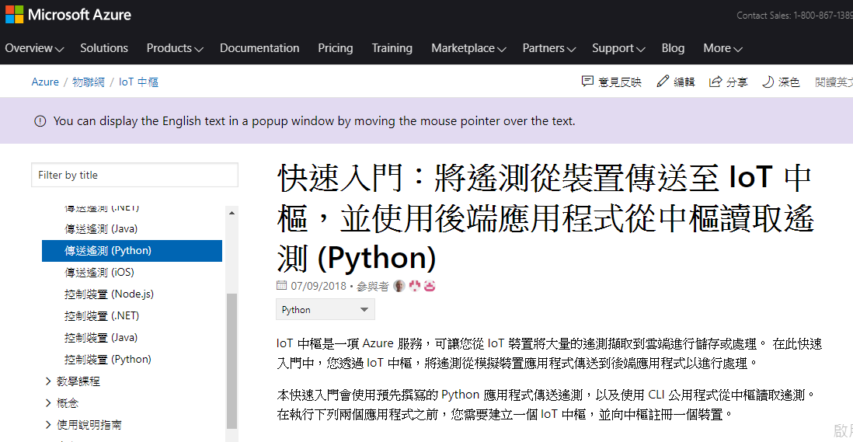
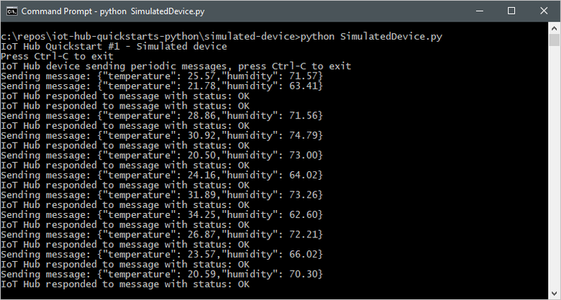
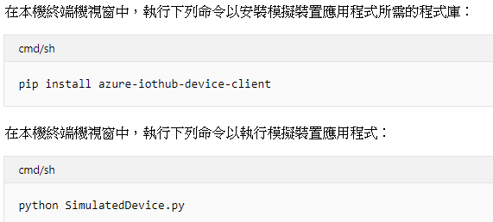
Simulator(Python)

Slide 10
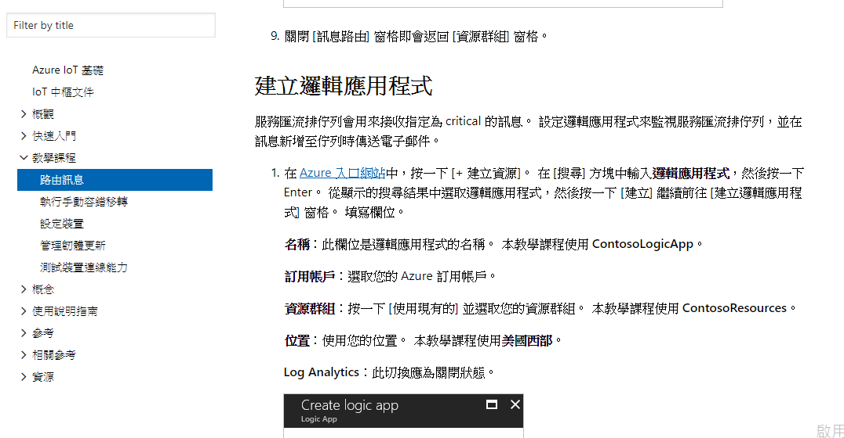
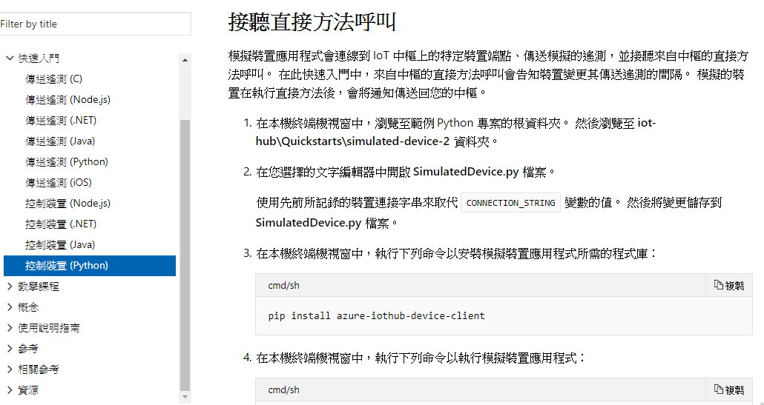
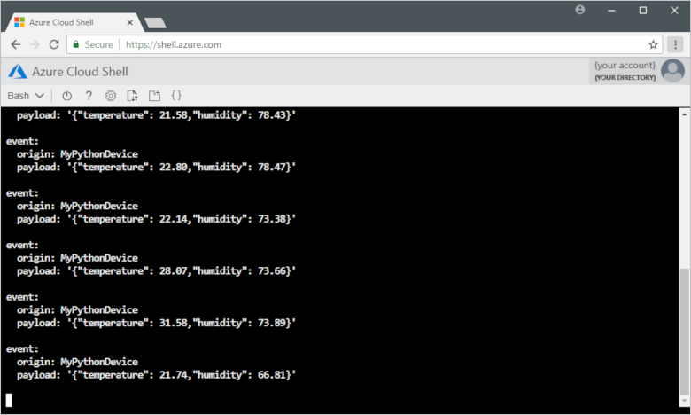
Simulator(Python)

Slide 11
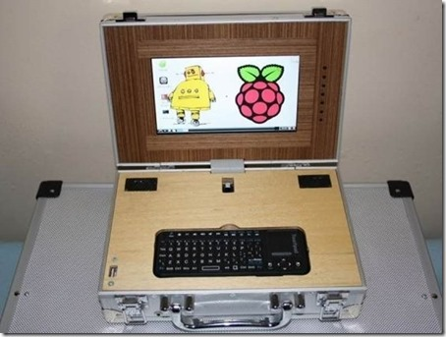
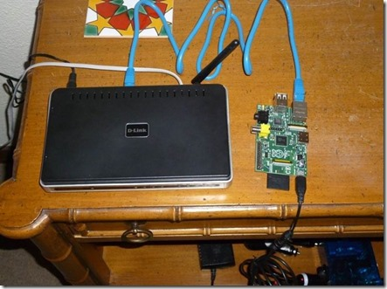
Application
文書處理器
架設各種網路站台

Slide 12
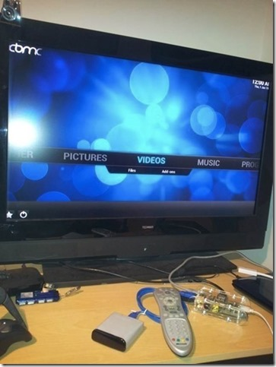
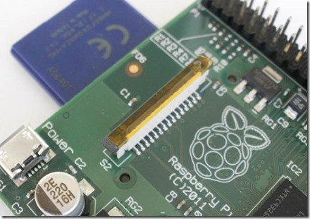
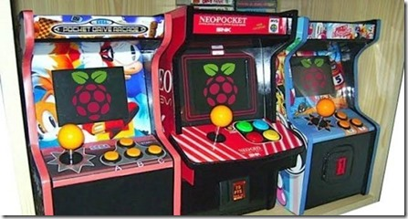
Application
變身成掌上型遊樂器
建立家庭影音劇院

Slide 13
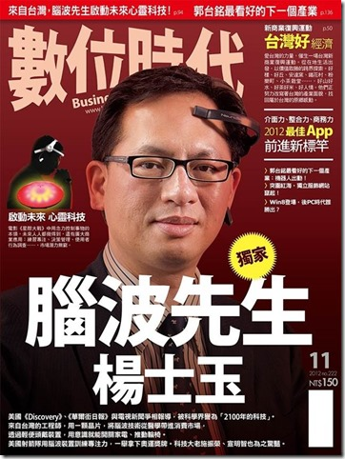
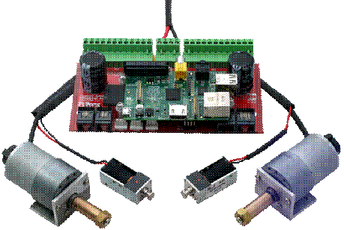
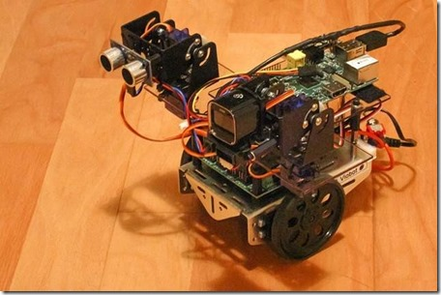
Application
控制自走車或機器人

Slide 14
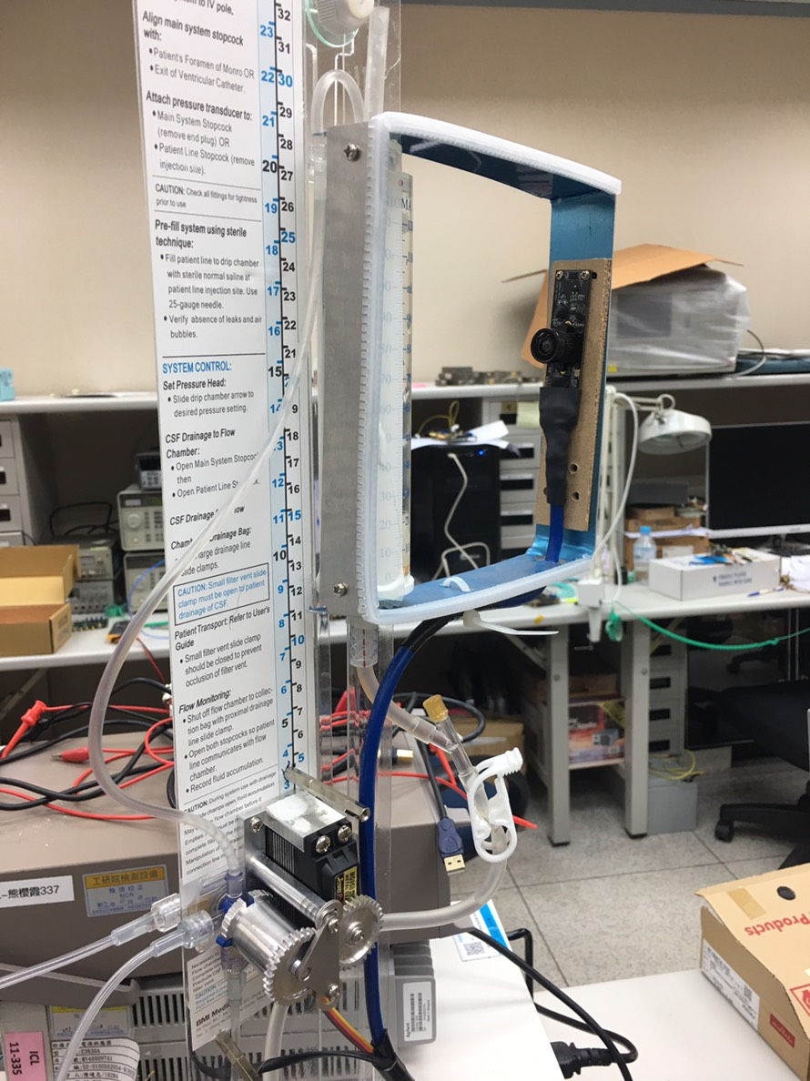
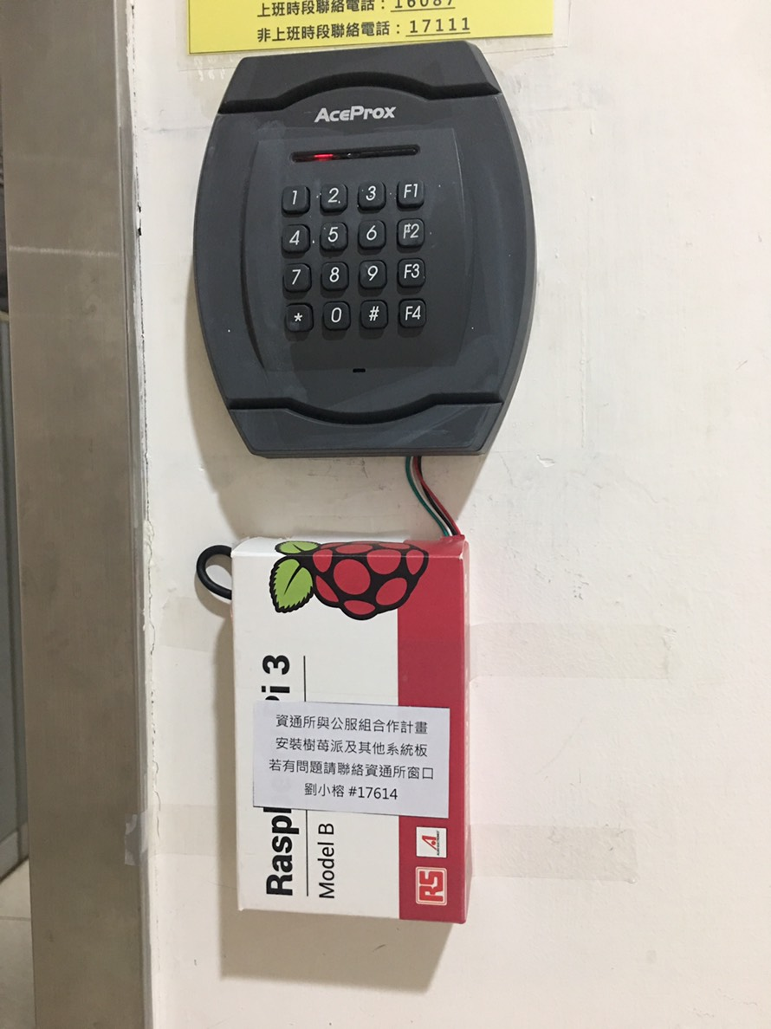
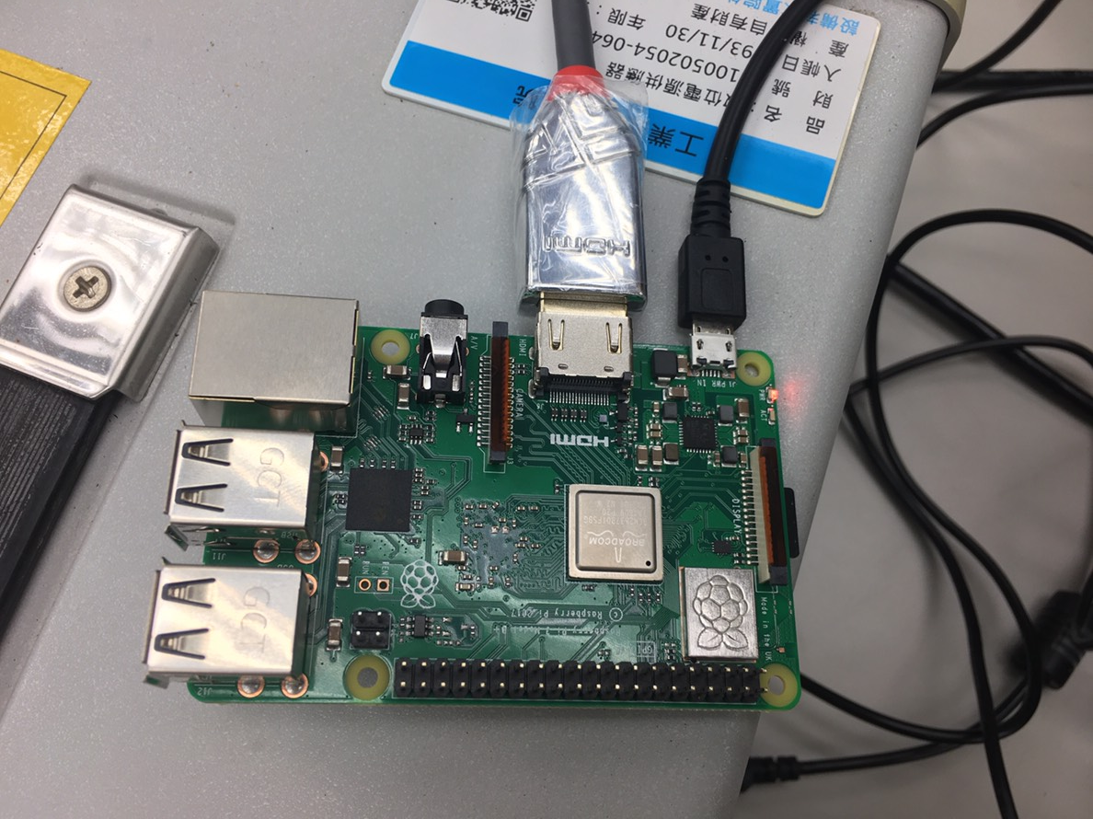
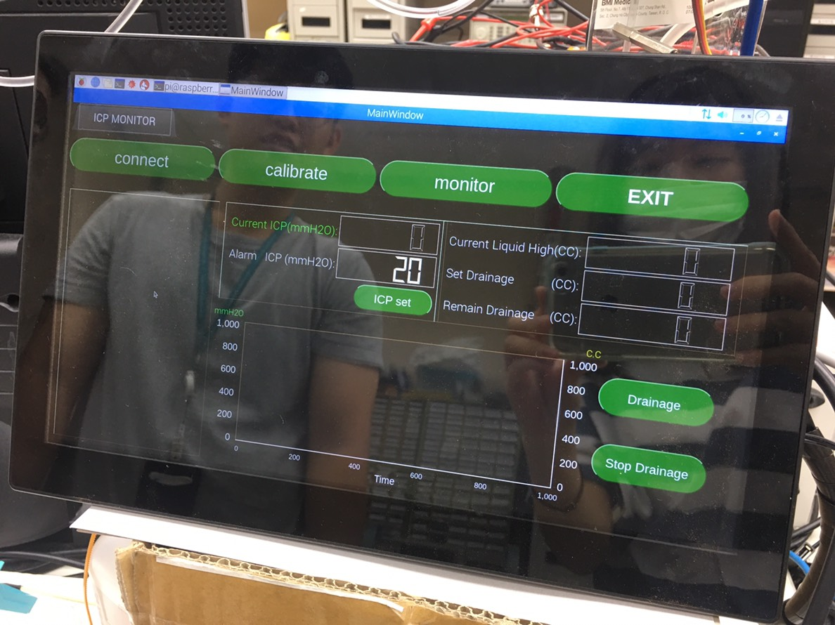
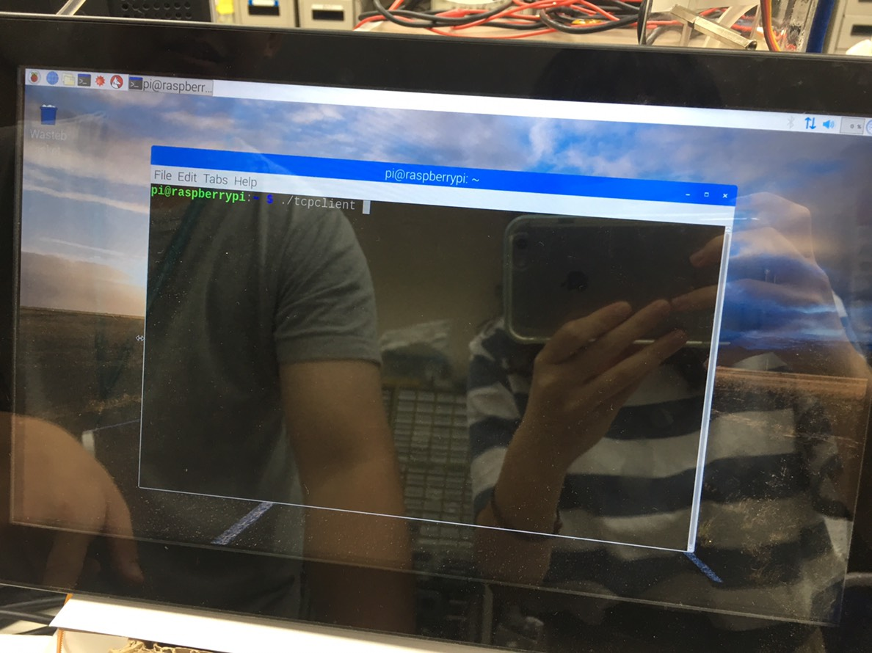
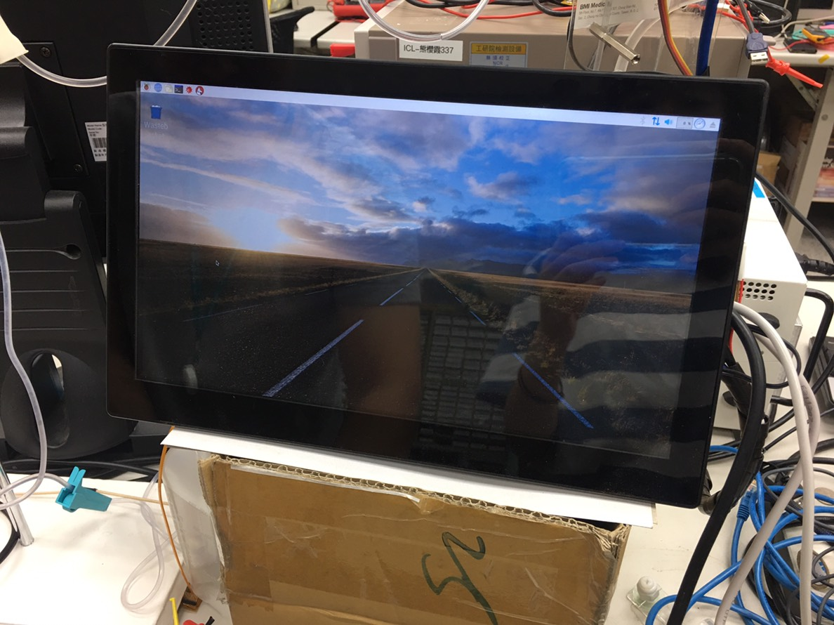
Application

Slide 15
Reference
https://zh.wikipedia.org/wiki/%E6%A0%91%E8%8E%93%E6%B4%BE#%E7%A1%AC%E9%AB%94
https://www.raspberrypi.org/documentation/usage/gpio/README.md
https://azure-samples.github.io/raspberry-pi-web-simulator/
https://docs.microsoft.com/zh-hk/azure/iot-hub/iot-hub-raspberry-pi-web-simulator-get-started
http://life-of-raspberrypi.blogspot.com/2012/12/raspberry-pi-66.html
https://docs.microsoft.com/zh-hk/azure/iot-hub/quickstart-send-telemetry-python
https://www.circuitcellar.com.tw/?p=1264
http://blog.cavedu.com/2018/03/14/raspberry-pi-3-%E7%82%BA%E6%82%A8%E4%BB%8B%E7%B4%B9%E6%96%B0%E7%89%88%E6%A8%B9%E8%8E%93%E6%B4%BE%E4%B8%83%E5%A4%A7%E7%89%B9%E9%BB%9E%EF%BC%9Araspberry-pi-3-model-b-plus/
http://www.powenko.com/wordpress/33-%E5%9C%A8%E8%97%8D%E8%8E%93%E6%B4%BE%E6%8E%83%E6%8F%8F%E6%A2%9D%E7%A2%BC%EF%BC%8C%E4%B8%A6%E4%B8%94%E6%8A%8A%E6%A2%9D%E7%A2%BC%E8%B3%87%E6%96%99%E5%84%B2%E5%AD%98%E7%9A%84%E6%AA%94%E6%A1%88/

